Slide 1



Session 8: Important SEO Tools

Slide 2
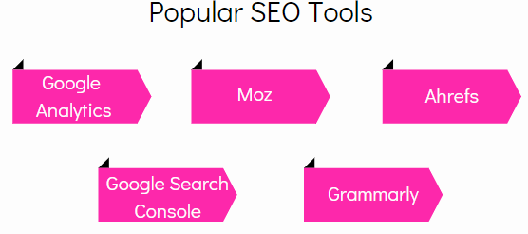
SEO Tools
▸ Manage and monitor the health of a Website
▸ Provide insights into all SEO components
▸ Optimize search to improve a site's rank in SERPs
▸ Analyze Web traffic to report server errors, sales, visitor count, and so on

Slide 3

Google Analytics
Is a popular SEO tool
Helps analyze:
Website/app performance
Visitor behavior
Web traffic
Versions:

Slide 4
Getting Started with Google Analytics
Steps to get started with Google Analytics:
Go to
Enter Website URL
Add business
Google.com/Analytics
information
Create/Sign In to the
Set Analytics
Accept the
Analytics Account
Tracking Code
Agreement
Configure Time
Connect Google Analytics to the Website
Click Start Measuring
Zone and preferred
Currency
Assign Account
Name
Assign Property
Name

Slide 5
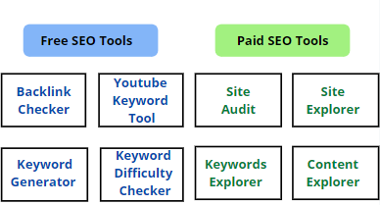
Ahrefs
▸ Ahrefs offers:
▸ To access its paid tools, follow these steps:
Go to https://app.ahrefs.com/user/login
Create Ahrefs account.
Verify the domain by setting up a
new project

Slide 6


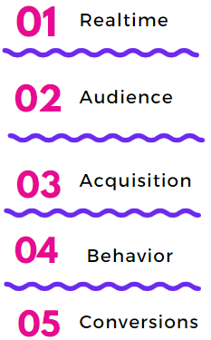
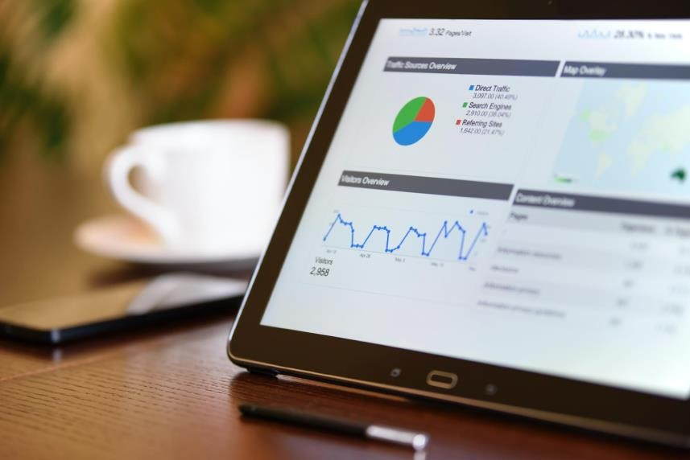

Google Analytics Reports

Slide 7
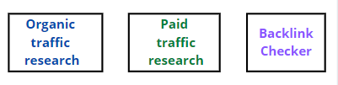
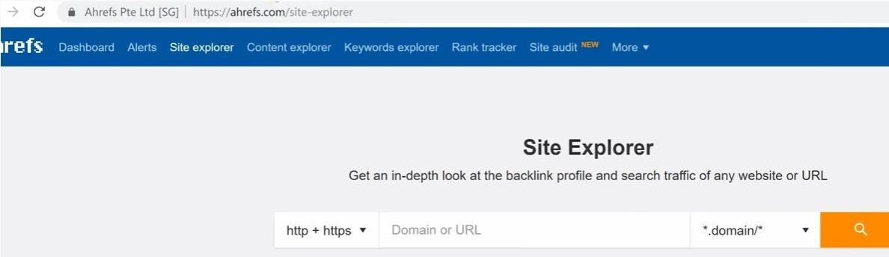
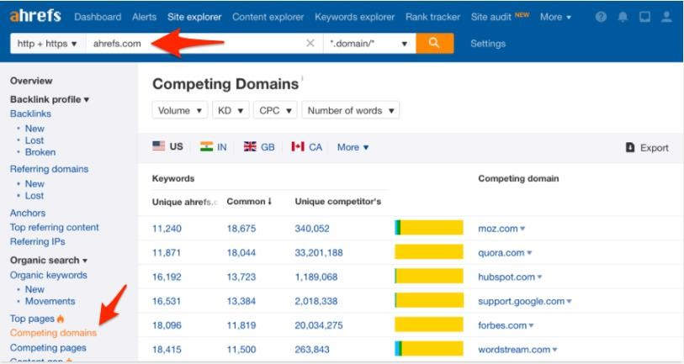
Site Explorer
▸ Ahrefs Site Explorer has three powerful tools:
▸ Provides in-depth information about organic search traffic and backlink profile of any Website or URL.
Site Explorer
Competing Domains

Slide 8



Grammarly
▸ Grammarly is an editing tool that:
Helps you write better content
Corrects punctuation mistakes and misspelled words
Provides basic suggestions for correcting document structure and grammar
▸ Steps to access Grammarly Editor from the browser:
Set up an account at https://app.gramma rly.com/
Click New to open a
Log in to see the
new
Grammarly dashboard.
document/click Upload to open an existing document.

Slide 9
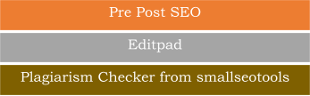
Plagiarism Checker
▸ Plagiarism is:
Copying content from a Website without giving credit to the source
Publishing copied work under your name
Considered unethical
Easily detected by search engines
▸ Free online plagiarism checker tools with certain word limit:

